Slide 1
The cloud is here. It is not some future thing.
Every project you submit will include both
A link to a github repo with all your bits
A link to a running version deployed on the Azure cloud.

Slide 2
Types of cloud services
IaaS Infrastructure as a Service: Empty virtual machines, networking, and storage. You configure it, you load the OS’s, install SQL, and the apps, you do the SW maintenance.
PaaS Platform as a Service: environment: hosted platforms, you supply the app. (what we will use)
Including high density hosting of websites where the resources are shared, how often does anyone really look at my site??
http://kurtsastro.azurewebsites.net/
build sites
using ASP.NET, PHP, Node.js, or Python
can be deployed using FTP, Git, Mercurial or Team Foundation Server
App can use MySQL, MongoDB, Azure SQL Databases, lots of other stuff
You have no idea what machine is running your software at any moment. Host OS and runtime get automatic patches and upgrades with no loss of downtime.
SaaS Software as a Service (application as a service) Multi-tenant architecture is highly efficient, same source code for every customer, meets customer requirement by simple configuration settings.
Office 360, Gmail, etc
SalesForce CRM
ancestry.com
surveymonkey.com
Azure DevOps

Slide 3
Also, many other cloud services
Storage Services provides REST and SDK APIs for storing and accessing data on the cloud.
Table Service: store structured text in partitioned collections of entities that are accessed by partition key and primary key. It's a NoSQL non-relational database.
Blob Service: store unstructured text and binary data as blobs that can be accessed by a HTTP(S) path.
Queue Service lets programs communicate asynchronously by message using queues.
File Services
Typically 2 or 3 way RAID sets.
Pub/Sub services
Many more

Slide 4
Cloud advantages
Dynamic growth and shrinking, pay only for what you use
High Availability
Geographic choices for speed, government regulations, taxes, disaster recovery, etc.
No massive initial capital investment, great for startups
Massive jobs (Hadoop), e.g. use 1000 computers for 2 hours, and then give them all back. (e.g. video image rendering)

Slide 5
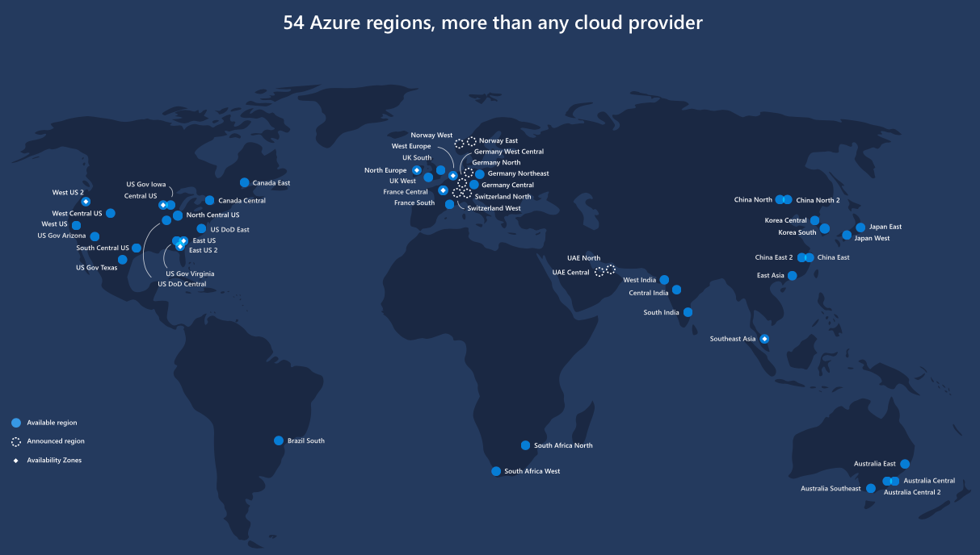
Azure regions (probably out of date)
Note the pairs for HA

Slide 6
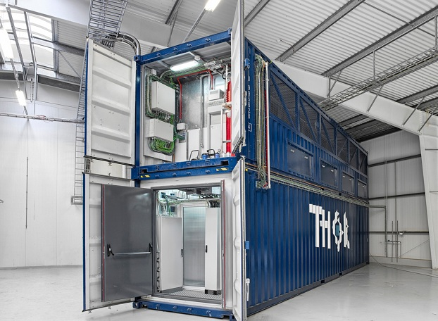
Computers, Storage, Networking built in an HP or Dell Factory and shipped as containers
Just plug in power, cooling, network

Slide 7
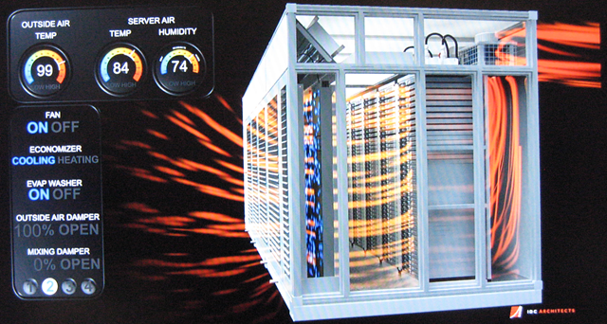

Slide 8
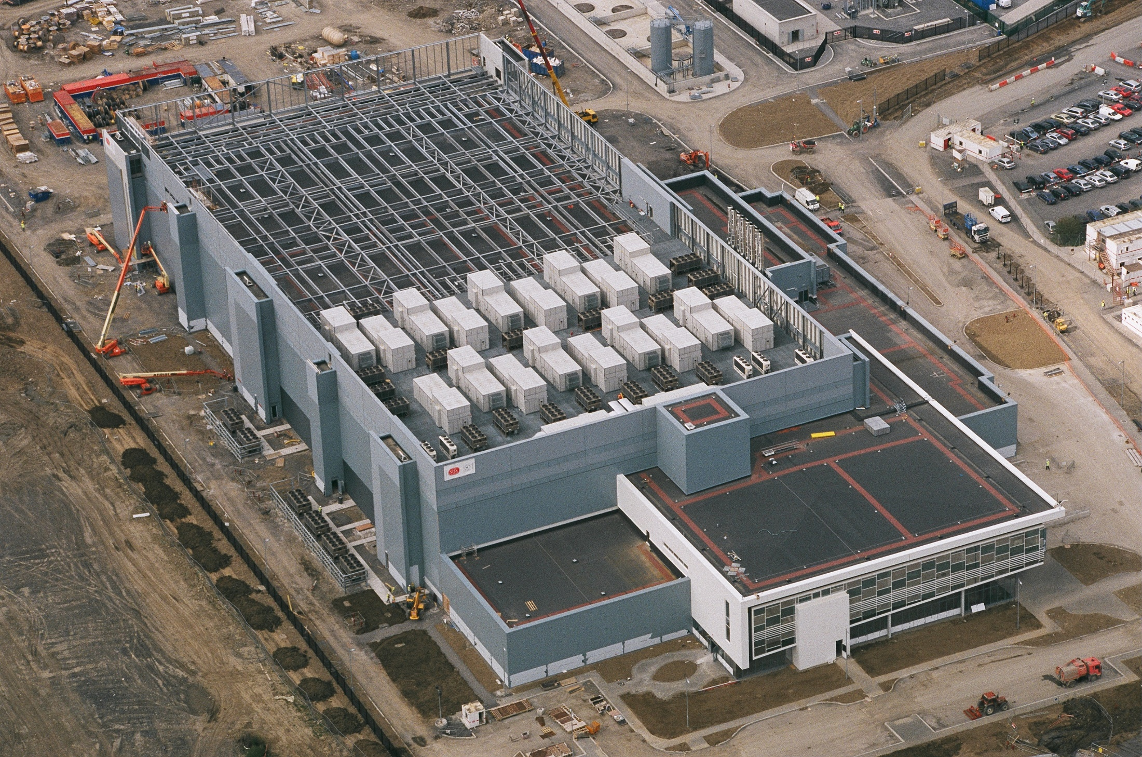
One of several at this site Dublin IR

Slide 9
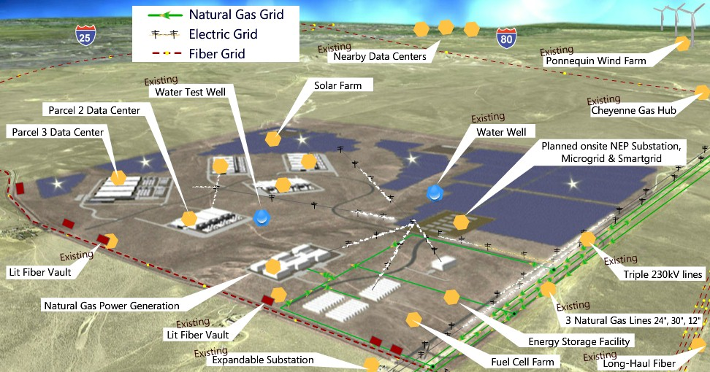
Wyoming Data Center

Slide 10
Your BC student DreamSpark account gets you a free Azure account
With a credit card, anyone can get a free Azure services
But as a student, you do not need a credit card. If Azure asks you for one, you have gone down an incorrect path.

Slide 11
There are many ways to get your bits hosted on Azure
You can push them directly from Code ( we will do this)
You can push them directly from Visual Studio
You can pull them up using the Azure Management Portal
You can keep your bits on github, and then, using the Azure Management Portal, point Azure to our github account

